Slide 1
Weekly report: Feedback & Lidar – Assisted Controller
Week number: 08
Date: 18/11/2025
Supervisor: Prof. Dr.-Ing. David Schlipf
Group members: Mirza Dincer, Saurabh Pankaj Jha, Midhun Kanichattu Venu
Presenter:-

Slide 2
List of Contents
Tasks of the Week
Optimization results
EOG simulation with updated static pitch curve

Slide 3
Tasks of the Week
Updating Brute Force Optimization to find global Optimum​
Adjust static pitch curve for 25 m/s simulation​ and run the EOG simulation again.
Tower Damper Implementation​ in ROSCO

Slide 4
DLC 1.2 Simulation Settings
660 seconds of simulation. Evaluation of values starts at t = 60 second to get settled values. Additionally, wind wraps around.
DLC 1.2 wind fields with average of 8 m/s to 24 m/s with steps with 4m/s, 3 seeds.
Enabled all DOFs.
Initial conditions of pitch angle, rotor speed and fore-aft tower position for every corresponding wind speed.
Running only feedback controller, no Lidar-assisted controller.

Slide 5
Lifetime Weighted DEL Results
Figure 1: Lifetime Weighted DEL Values for each vector

Slide 6
AEP Results
Figure 2: AEP values for each vector

Slide 7
Optimization results
Kp_k sets the overall level of the Kp vector in the ROSCO input file. As the absolute value of Kp_k increases, the absolute values of Kp also increase, so the pitch is controlled more aggressively.
Theta_k sets how quickly the Kp vector changes with theta in the ROSCO input file. If Theta_k is smaller theta points, makes Kp vary more strongly between theta points, so the controller becomes more aggressive in some theta points and less in others. If Theta_k close to theta points, makes Kp change more gradually, so the controller behaviour is more uniform over the operating range.
It looks like we are near the global optimum because as we decrease Kp_k and increase theta_k, difference between each vector getting lower.

Slide 8

Equation for cost calculation
$$J=\frac{\max\left(\left|Ω−Ω_{0}\right|\right)}{Ω_{0}}+\frac{\max\left(\left|M_{yT}−M_{yT0}\right|\right)}{M_{yT0}}$$
J = Cost,
Ω = rotor speed,
Ω₀ = steady-state rotor speed at rated wind speed.
MᵧT = fore-aft tower base bending moment,
MᵧT₀ = steady-state moment at rated wind speed.
Penalizes the maximum deviation in rotor speed and tower load from steady state.
Tests the controller’s ability to keep rotor speed and tower motion smooth during the gust.
Cost terms represent the two key responses:
  Rotor motion
  Fore-aft tower bending
[1]

Slide 9
T_buffer
T_buffer is the timing delay that synchronizes lidar preview with the real gust arrival, ensuring the controller reacts neither too early nor too late.
Purpose
Lidar detects the gust before it arrives (preview).
The turbine and pitch actuators have response delays.
The wind signal must therefore be buffered so the feedforward action is applied exactly at the right time.
[2]

Slide 10
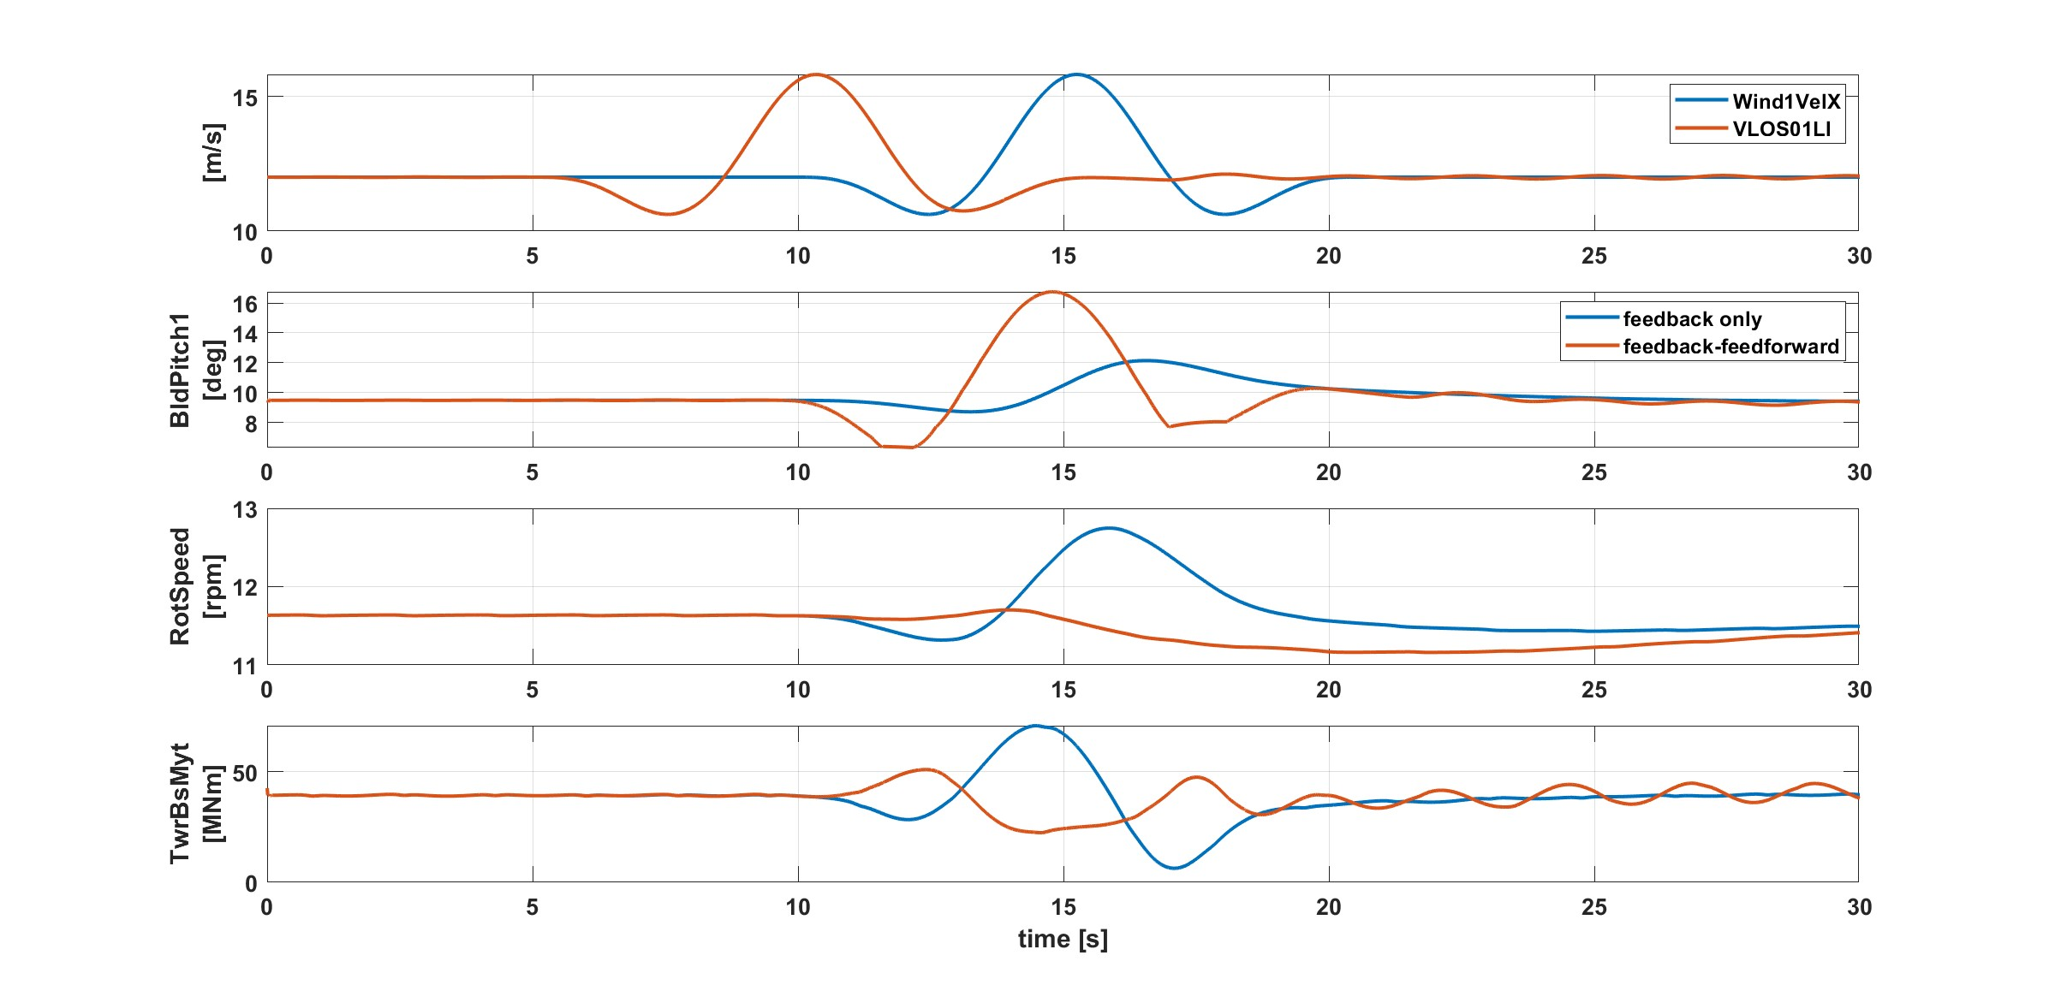
Wind speed 12m/s
Figure 3: Comparison of controllers over 12 m/s EOG
Cost for feedback feedforward: 0.644569 with t_buffer = 4.5s
Cost for feedback only : 0.983657

Slide 11
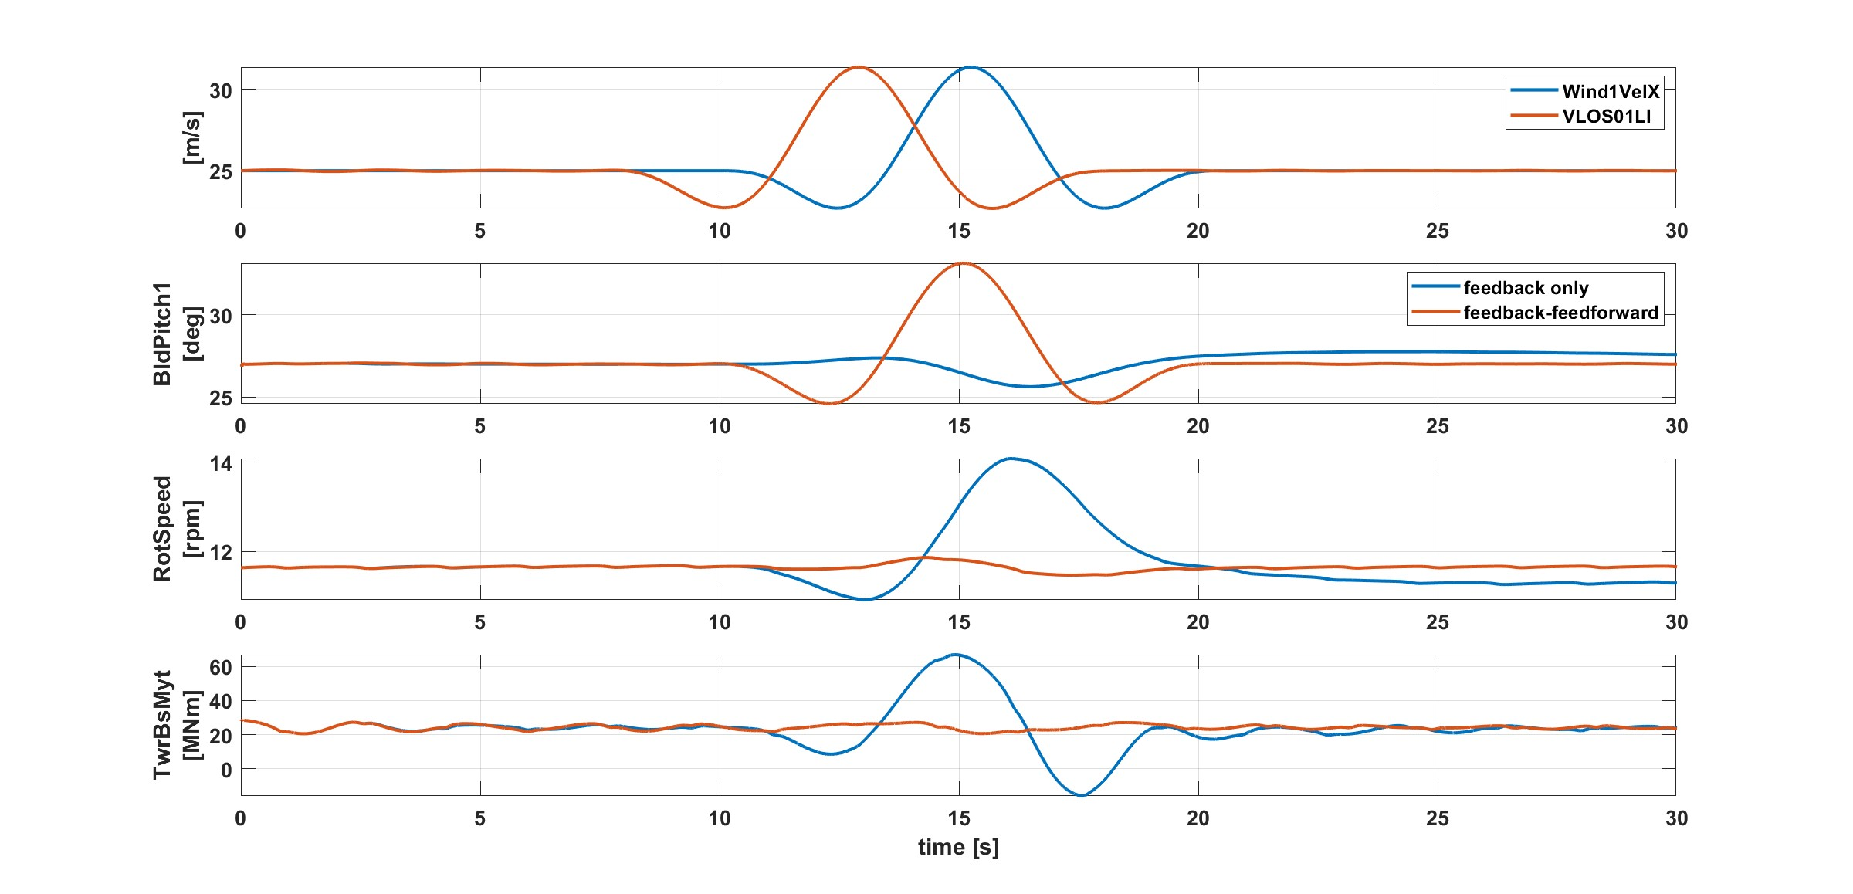
Wind speed 25m/s
Figure 4: Comparison of controllers over 25 m/s EOG
Cost for feedback feedforward: 0.645354 with t_buffer = 2.1s
Cost for feedback only: 1.487102

Slide 12
Tower Damper
It is used to mitigate tower oscillations and reduce structural loads.
It aims to suppress the fundamental fore-aft tower mode by reacting to measured or estimated tower-top velocity.
A high-pass filter is added to ensure that only the specific frequency components associated with the first tower fore-aft mode are targeted for damping, ignoring slow drift (low-frequency effects) and steady-state signals.
The tower damper uses tower acceleration that is then integrated to obtain velocity.
Feedback & Lidar Controller / Optimus Syria

Slide 13
Implementation in ROSCO
Tower top fore-aft acceleration measurement.
High-pass filter removes low-frequency content, Isolates tower natural frequency vibrations
Integrates acceleration → velocity
Same pitch adjustment applied to all blades
Tower damping pitch command added to collective pitch command, then combined with IPC (Individual Pitch Control)

Slide 14
Conclusion
Kp_k and Theta_k effects on optimization for ROSCO input is understood.
It is seen that full static pitch curve for Lidar-Assisted controller is needed for extreme wind speeds.
Tower damper in ROSCO is understood.
Next weeks:
Start with Optimus Turbine

Slide 15
Biblography
[1] D. Schlipf et al., “IEA Wind Task 52 LAC Summer Games 2024,” Zenodo, Aug. 2024, doi: https://doi.org/10.5281/zenodo.13235189.
[2] W. Fu, F. Guo, D. Schlipf, and A. Peña, “Feedforward pitch control for a 15 MW wind turbine using a spinner-mounted single-beam lidar,” Wind Energy Science, vol. 8, no. 12, pp. 1893–1907, Dec. 2023, doi: https://doi.org/10.5194/wes-8-1893-2023.

